Slide 1
Chapter 6
Visual Perception

Slide 2
Perception of Depth

Slide 3
Perception of Depth
Visual cues provide depth information
Monocular – cues that require only one eye
Stereo – cues that require or benefit from both eyes

Slide 4
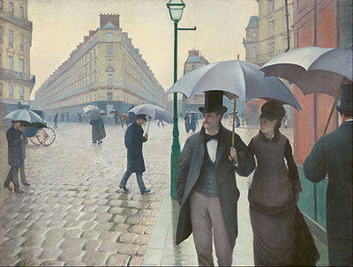
Paris Street, Rainy Day,” Gustave Caillebotte,1877. Art Institute of Chicago

Slide 5
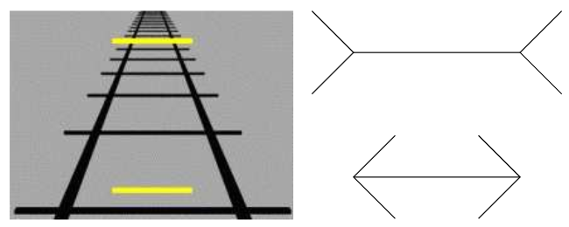
Monocular illusions

Slide 6
Monocular perception
In principal it works by comparing relative objects visible size based on some known or assumed size
The closer an object the larger it is on the retina
Shape and texture can be

Slide 7

Ebbinghaus illusion

Slide 8
Monocular Perception Cont.
Hight in visual field – objects as they approach the horizon appear to be larger and further away in-spite of their identical size
Accommodation – youths given up-to 10 Diopters of variance can bring objects in and out of focus this ability diminishes due to aging

Slide 9
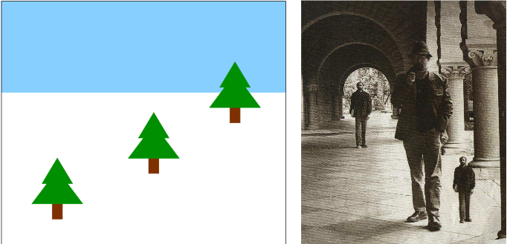
Example of horizon playing a role in depth perception Size change based on proximity

Slide 10
Monocular Perception cont.
Motion Parallax – objects in the foreground move quicker relative to objects the background using time to “fake” stereo vision

Slide 11
https://stonetree-world.tumblr.com/post/151700717208

Slide 12
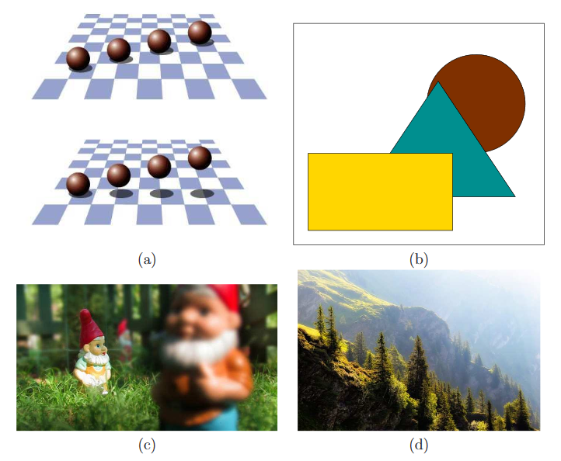

Slide 13
Stereo Perception
Horopter – The space in which both eyes converge on an object
binocular disparity – The phenomena where the brain must resolve 2 distinct images one from each eye
Diplopia – the name of the effect easiest to notice for close objects but holds true for far objects when focusing on something close

Slide 14
Perception of Motion

Slide 15
Motion Detection Mechanisms
Reichardt detector -

